Slide 1
Lecture 2

Slide 2
Agenda
Backpropagation: Single Input
Backpropagation: Batched case
Updating weights
Example: Predicting the value of Sin(x)
Minibatch Stochastic Gradient Descent
Implementing MSGD
Pytorch Dataloader/Dataset classes

Slide 3
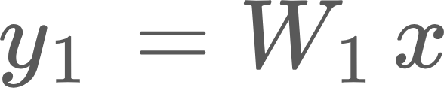
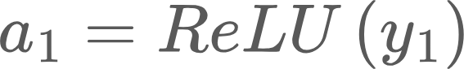
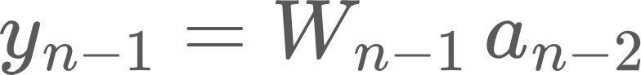
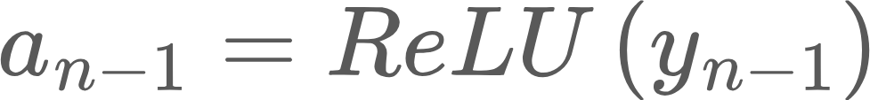
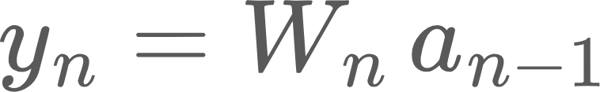
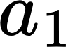
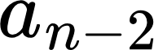
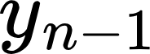
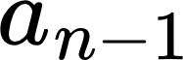
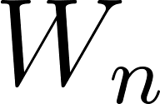
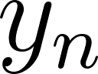
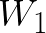
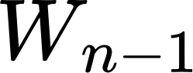
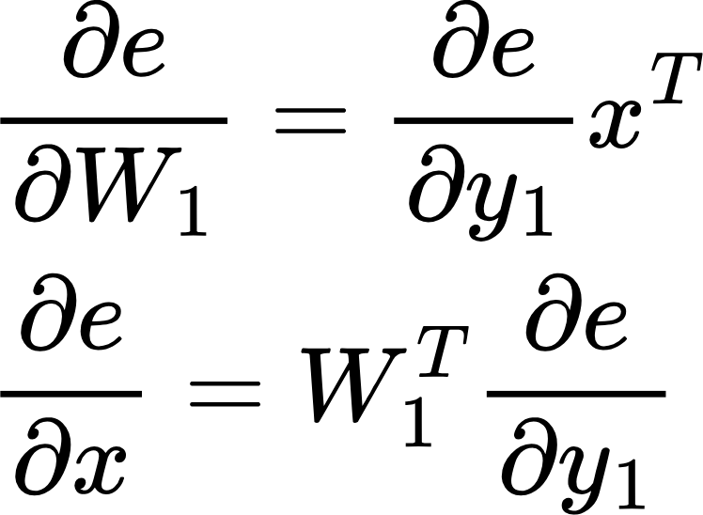
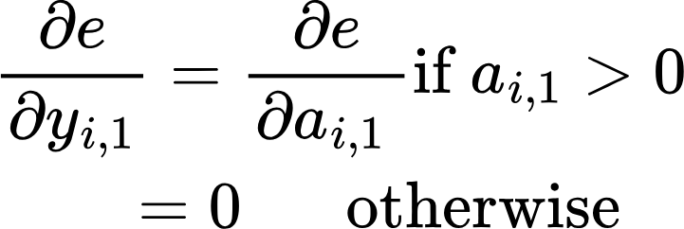
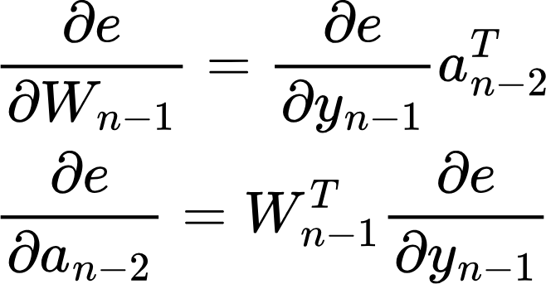
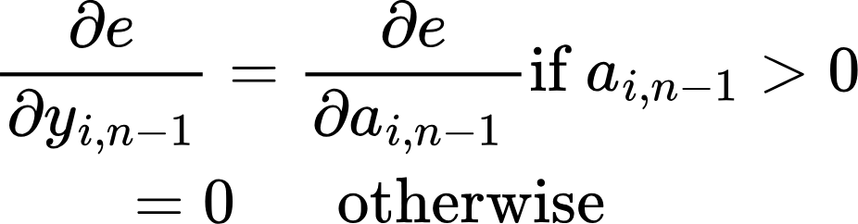
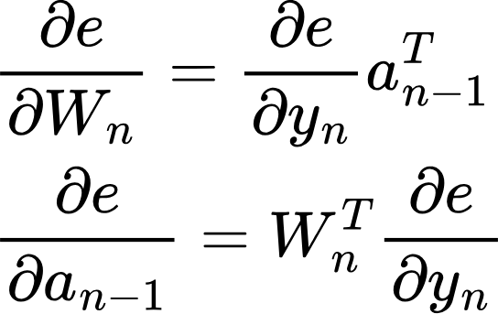
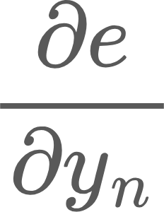
Backpropagation
Forward Pass or Inference
labels
ReLU
ReLU
Loss function (L)
…
Error
e = L(y)
Backward pass
(Training)
No parameters!
Notice we need the output of the previous layer in the backward pass!
Sent back to previous layers
Used to update the weights of this layer

Slide 4
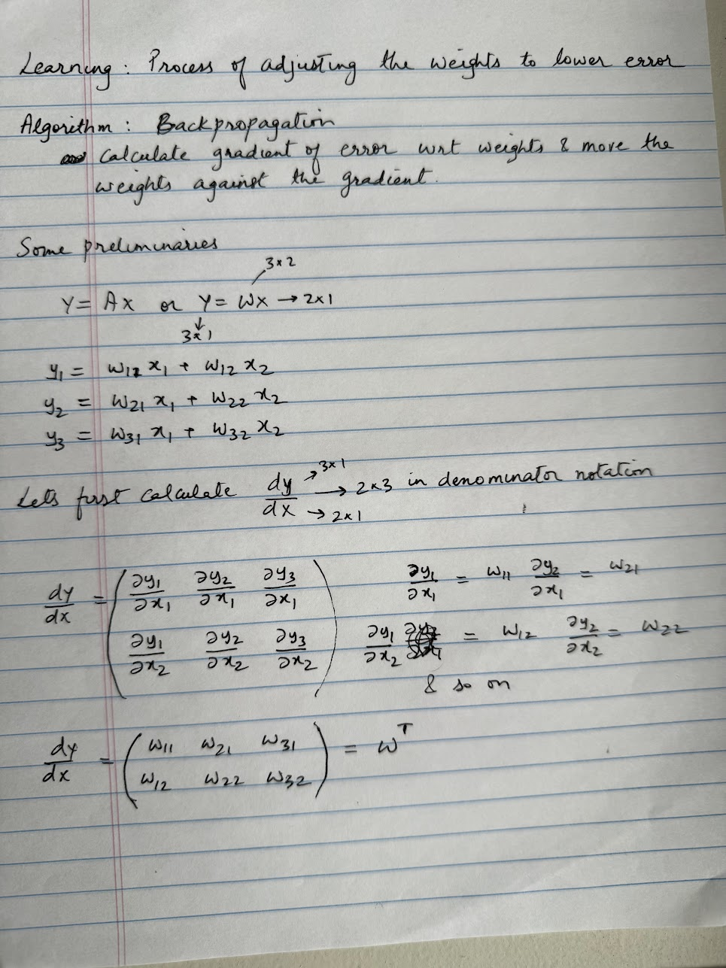
Backpropagation
Learning is the process of adjusting the weights of the layers in a network against the gradient.
This is done using an algorithm called Backpropagation.
Key idea is to calculate the derivative of the error against the parameters of the network, and move the parameters against the gradient to gradually lower the error, which directs the network’s output towards the desired output

Slide 5
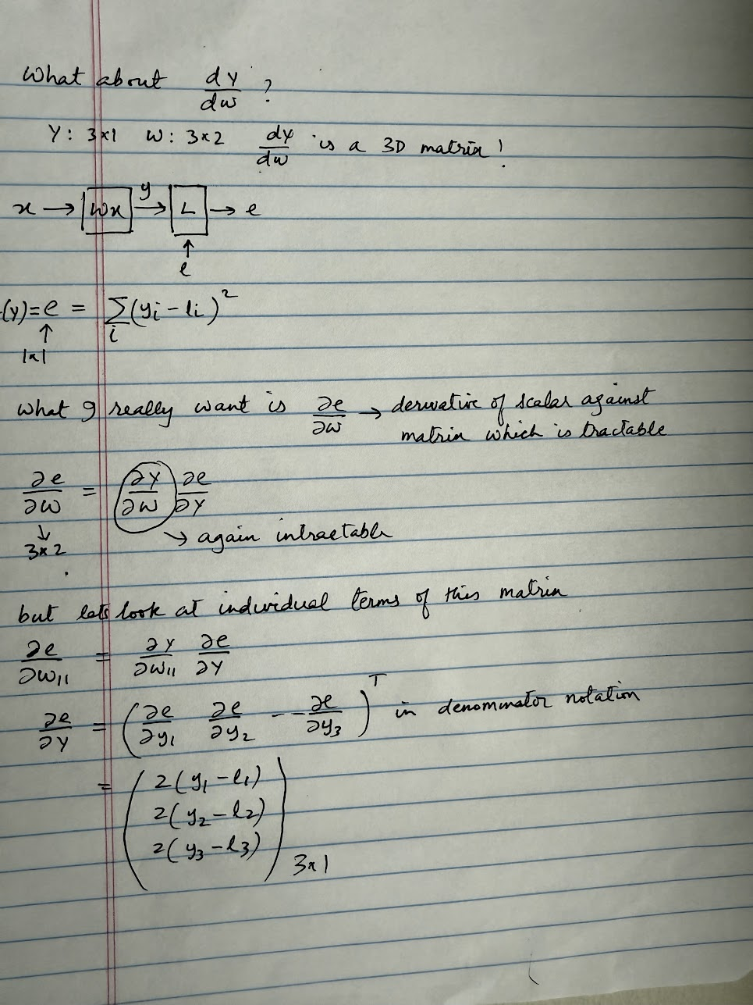
Backpropagation
Calculating the derivative of the error against the parameter matrix
Here our loss function is “squared error”
There are several loss functions:
Root Mean Square
Cross Entropy Loss
Contrastive Loss
We’ll look at these later in the course

Slide 6
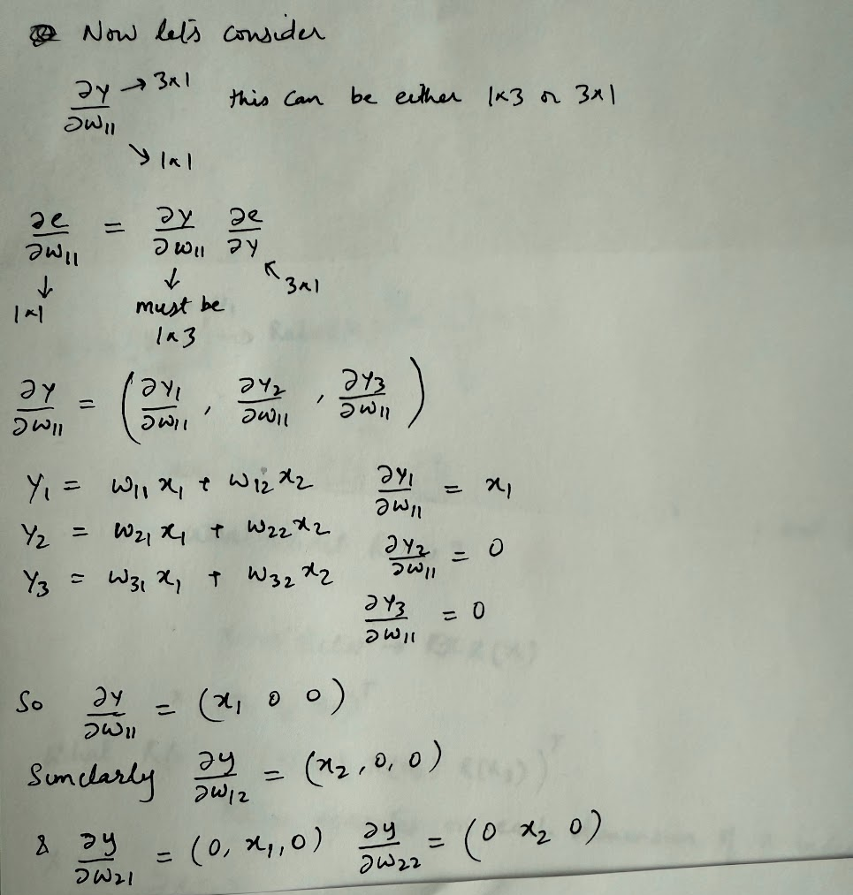
Backpropagation
Calculating the derivative of the error against the parameter matrix

Slide 7
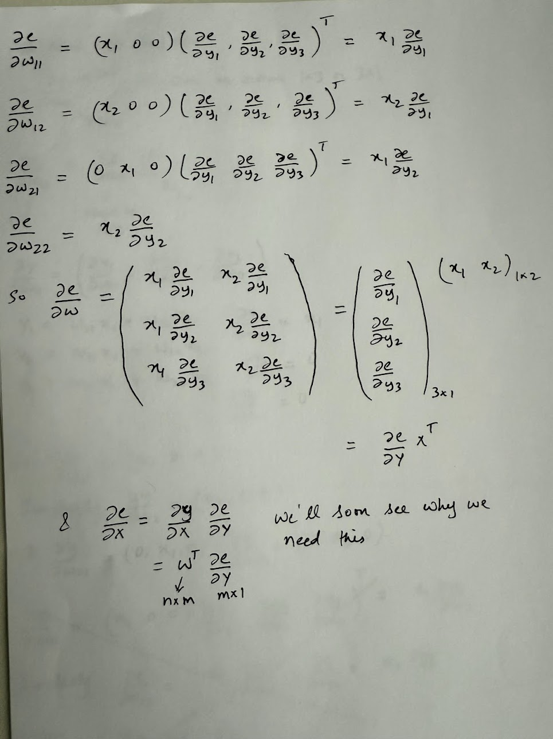
Backpropagation
Calculating the derivative of the error against the parameter matrix
This is a key result, because in a typical Transformer model, matrix multiplications account for a significant portion of the operations, often exceeding 80% of the total runtime.

Slide 8
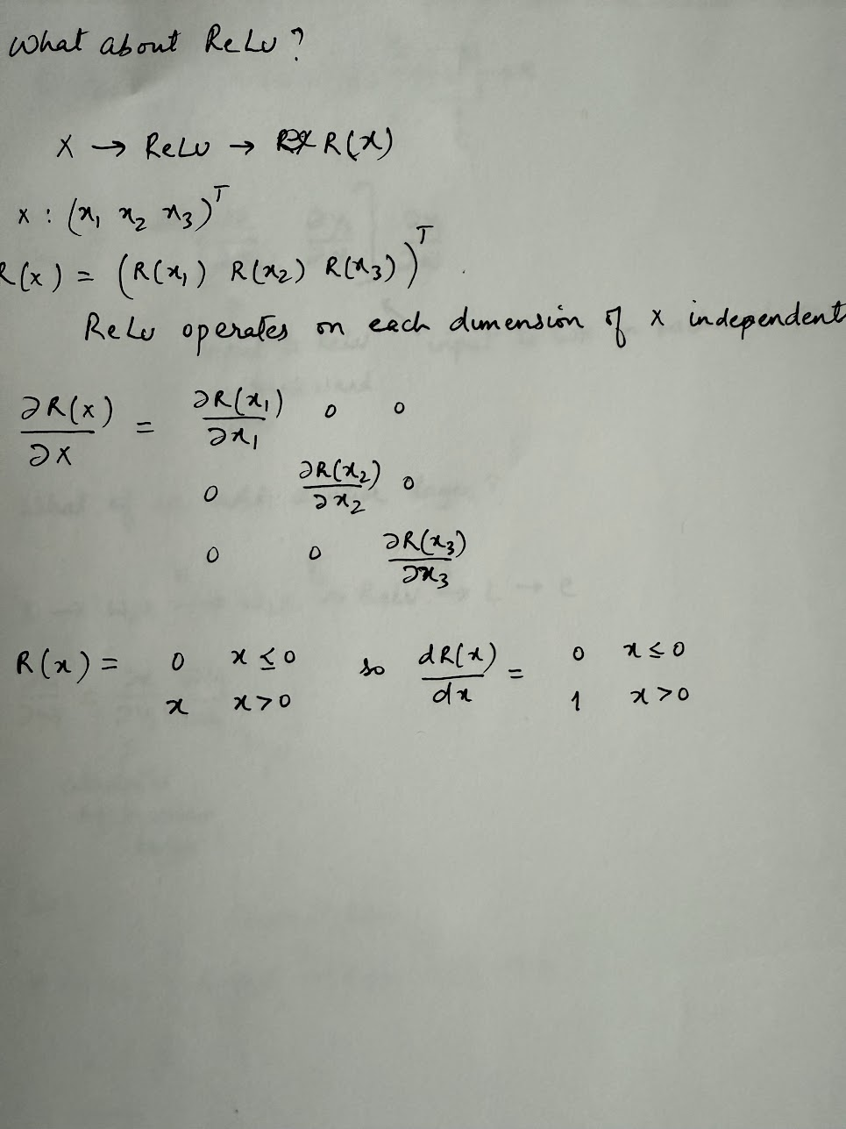
Backpropagation
Let’s look at ReLU now..
Note: In the derivation on the right, we are consider x as a 3*1 vector just as an example. In general, x would be a m*n matrix
Note: ReLU doesn’t have any parameters.. But we still need to calculate the derivative of its output against input

Slide 9
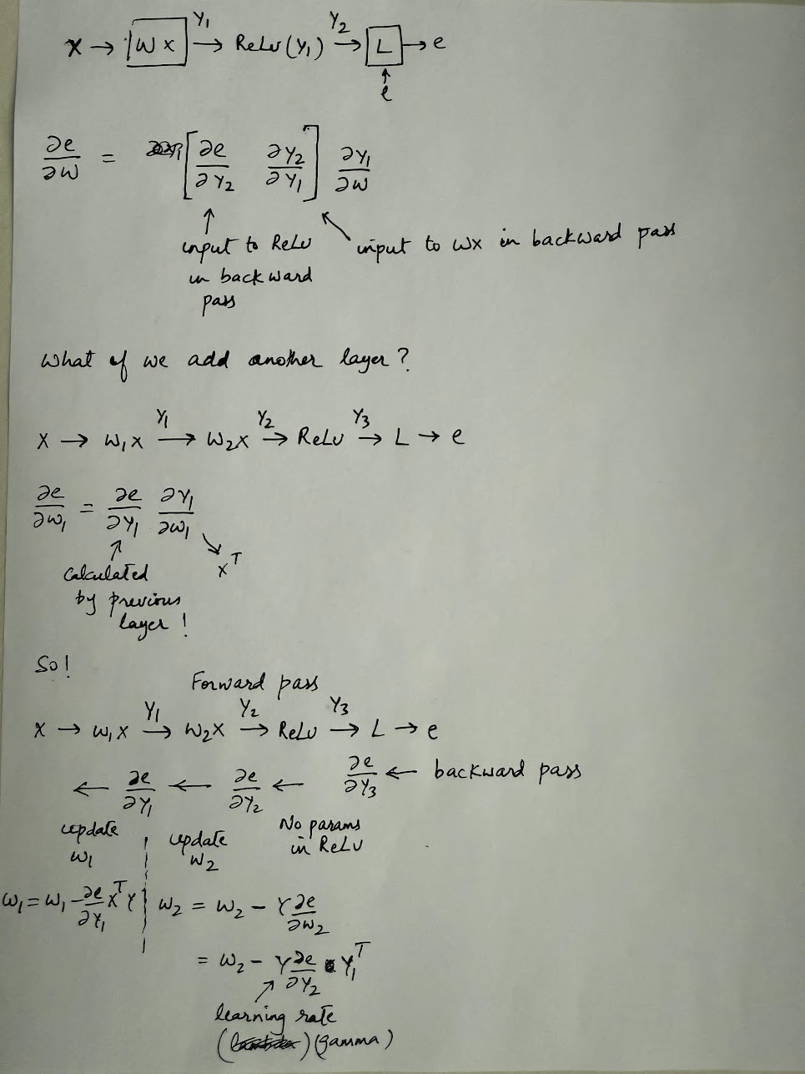
Backpropagation
Calculating the derivative of the error against the parameter matrix
Each layer uses the derivative of error against its output to calculate derivative of error against its parameters, and the derivative of error against its inputs, which is propagated back to the previous layer..

Slide 10
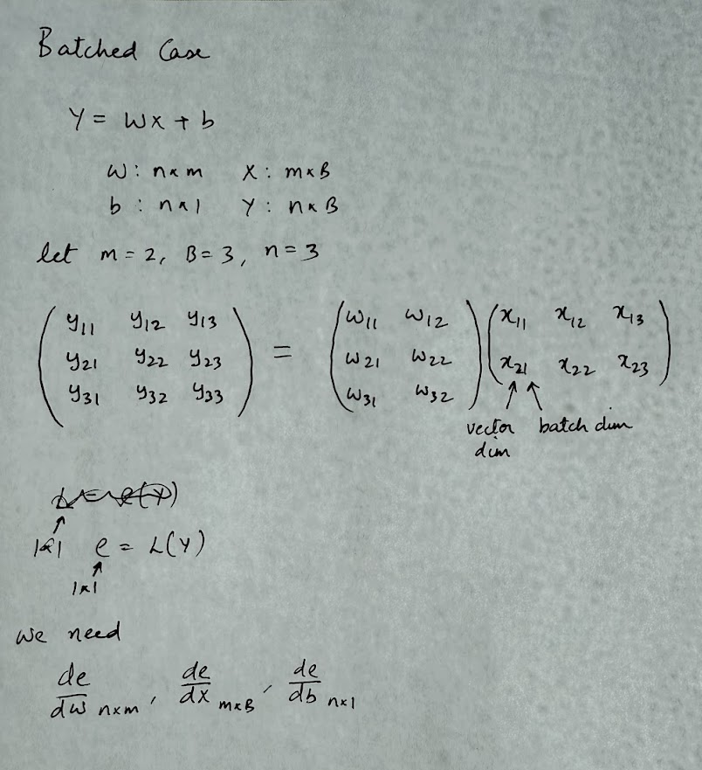
Backpropagation: Batched
So far, we calculated gradients for a single input. It is common to group the inputs into a batch. Let’s calculate the gradients for the batched case. We’ll also include the bias term now

Slide 11
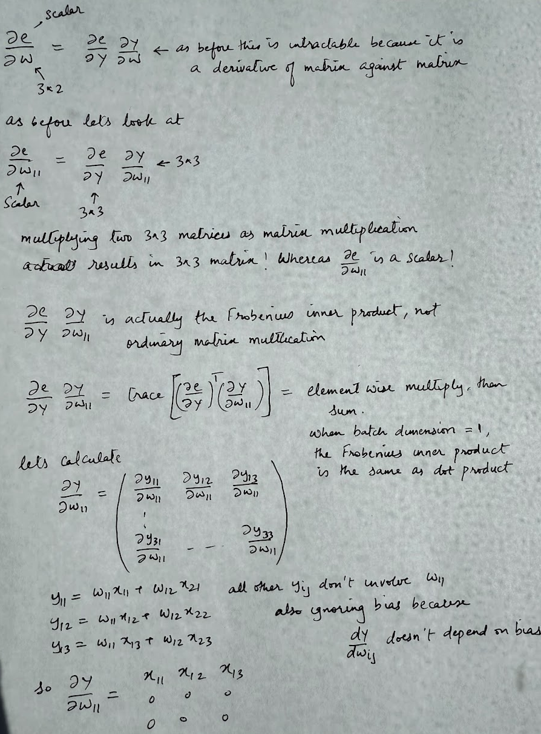
Backpropagation: Batched
Derivative of error against the weights

Slide 12
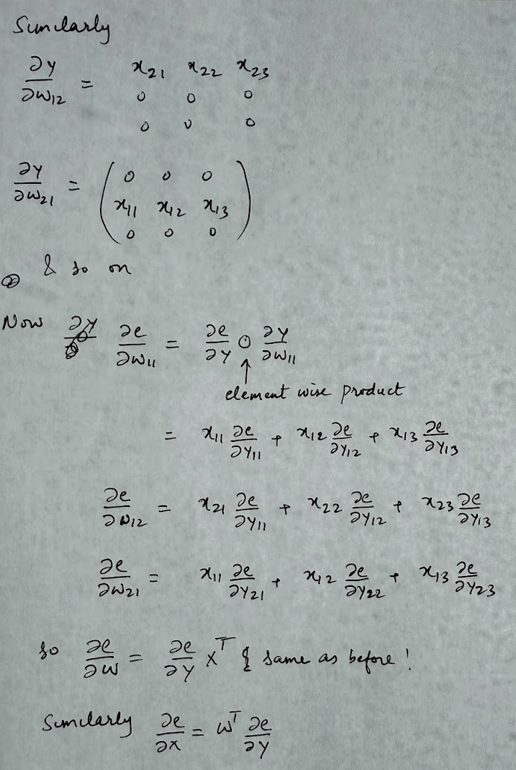
Backpropagation: Batched

Slide 13
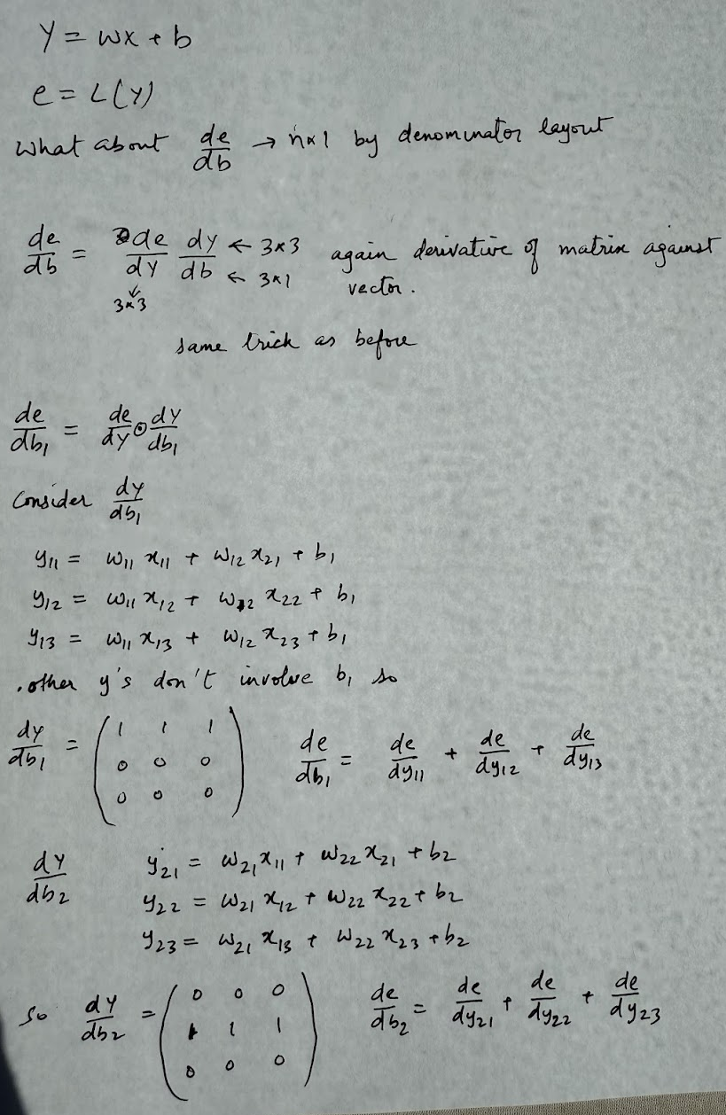
Backpropagation: Batched
Derivative of error against bias

Slide 14
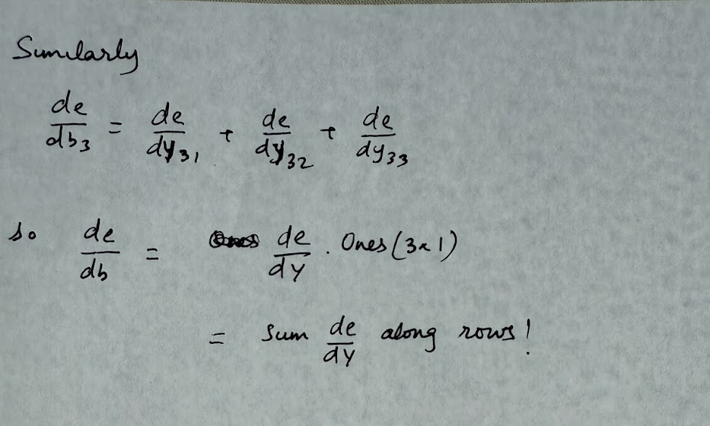
Backpropagation: Batched

Slide 15
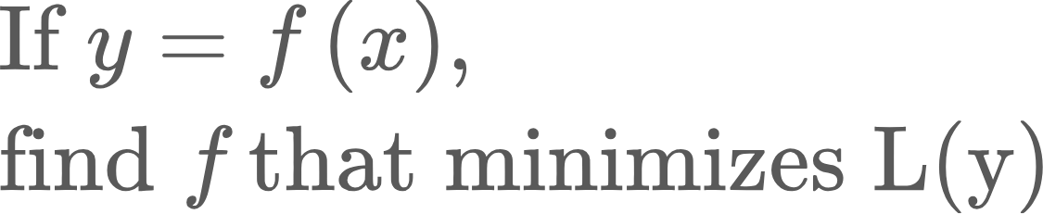
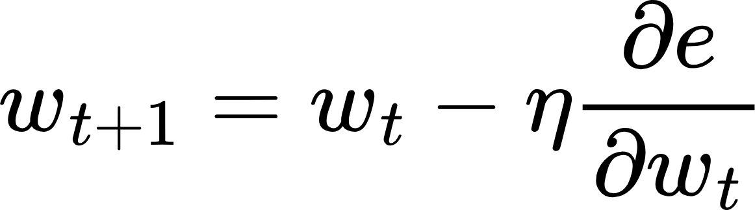
Updating Weights..
We calculated all these gradients.. Now what?
Recall the original optimization problem..
We modeled the unknown function f as a neural network, because neural networks can model any arbitrary function. Finding f means finding the weights of the network that minimize the loss function. We calculated the gradients so we know which direction to move the weights.
Learning rate.. This should get smaller as we get closer to the minimum

Slide 16
Updating Weights..
Video

Slide 17
Stochastic Minibatch Gradient Descent
How do we select the batch size?
Say we have n data points
1<B<n
Select a subset of the dataset at every iteration (without replacement). Calculate gradient and update weights. Do until we sweep through the entire dataset
Best of both worlds. Stable gradients, lower compute
B=1
Select a random point from the dataset (without replacement)
Calculate gradient and update weights
Problem: Gradient is very noisy
B=n
Select the entire dataset at every iteration
Calculate gradient and update weights
Problem: Large matrices, compute heavy
n
Sample B=m at each iteration. A sweep through the entire training dataset is called an epoch. Number of iterations in an epoch: n/B, assuming B divides n

Slide 18
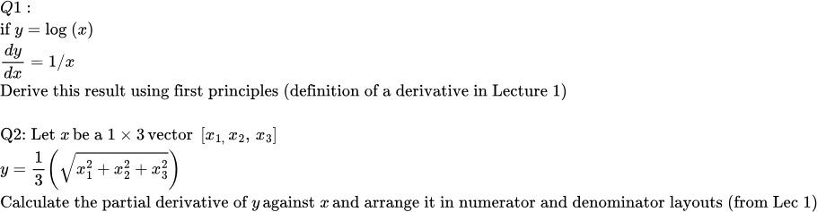
Homework
Q3: This code implements the math in slides 3-8. Run it in your favorite Python IDE (Pycharm recommended) and make sure you understand what’s going on. Do the exercise at the bottom of the code

Slide 19
What’s next..
Can I use other non-linearities?
How do I initialize weights?

